Slide 1
INFS 774 Big Data Analytics
Week 3

Slide 2
Introduction to MapReduce

Slide 3
Features of MapReduce
Automatic parallelization and distribution
Fault tolerance
A clean abstraction for programmers
– MapReduce programs are usually written in Java
– Can be written in any language using Hadoop Streaming
– All of Hadoop is written in Java
MapReduce abstracts all the ‘housekeeping’ away from the developer
– Developer can simply concentrate on writing the Map and Reduce functions

Slide 4
Key MapReduce Stages
Map
– Each Map task (typically) operates on a single HDFS block (splits)
– Map tasks (usually) run on the node where the block is stored (data locality) a list of key/value pairs.
Shuffle and Sort
– Sorts and consolidates intermediate data from mappers
– Happens after Map tasks and before Reduce tasks
Reduce
– Operates on shuffled/sorted intermediate data (Map task output)
– Produces final output

Slide 5
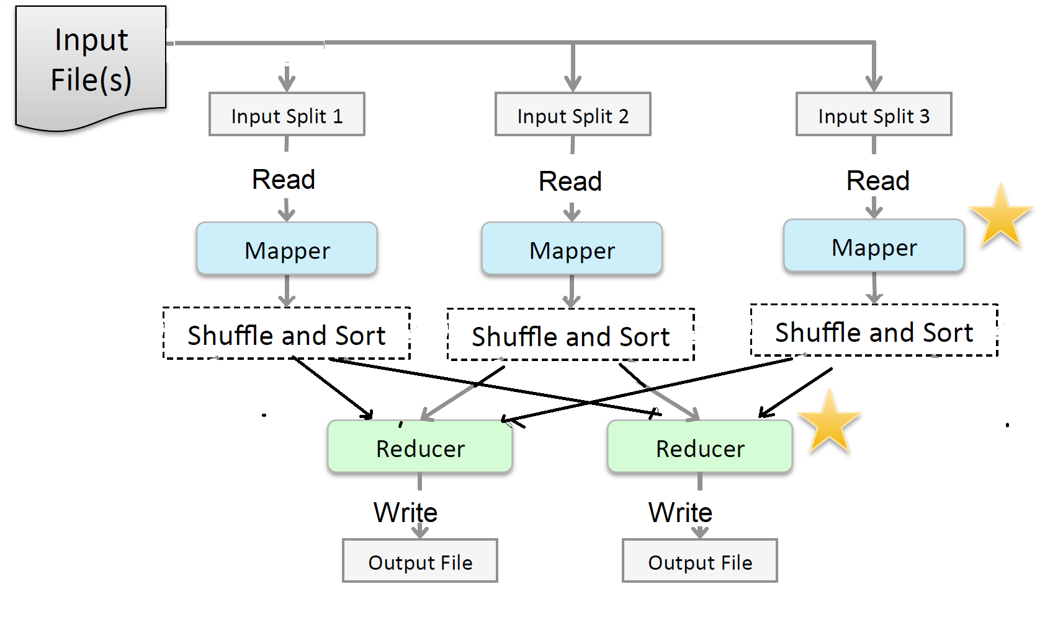
The MapReduce Flow
Notes:
Mapper a program that perform map() data node -> multiple mapper ->multiple reducers (4:1) container (v2) slot (v1)
Reduce()

Slide 6
WordCount example
Output (HDFS)
and | 1
check | 1
compute | 1
for | 1
input | 2
job | 2
of | 1
output | 1
specification | 1
the | 4
values | 1
Input data(HDFS file)
check the input and output specification of the job
compute the input values for the job
…….

Slide 7
WordCount example (cont.)
Memory and local file system
Key | Value
check | 1
the | 1
input | 1
and | 1
output | 1
specification | 1
of | 1
the | 1
job | 1
Input data(HDFS file)
.
check the input and output specification of the job
compute the input values for the job
…….
Mapper
Record Reader
Map()
Key | Value
compute | 1
the | 1
input | 1
values | 1
for | 1
the | 1
job | 1
Key | Value
0 | check the input and output specification of the job
52 | compute the input values for the job
89 | …
Map()

Slide 8
WordCount example (cont.)
Outputs from map()
Key | Value
check | 1
the | 1
input | 1
and | 1
output | 1
specification | 1
of | 1
the | 1
job | 1
key | value
and | 1
check | 1
compute | 1
for | 1
input | 1, 1
job | 1, 1
Reducer
Shuffle & sort
reduce()
Key | Value
compute | 1
the | 1
input | 1
values | 1
for | 1
the | 1
job | 1
reduce()
of | 1
output | 1
specification | 1
the | 1,1,1,1
values | 1
Notes:
Node-1: Two mapper on the same File sorted (input 1)
Node2: big file (input, 1)
Input, [1, 1]

Slide 9
WordCount example (cont.)
Final outputs to HDFS
key | value
and | 1
check | 1
compute | 1
for | 1
input | 1, 1
job | 1, 1
key | value
and | 1
check | 1
compute | 1
for | 1
input | 2
job | 2
Reducer
reduce()
Shuffle&sort outputs
reduce()
of | 1
output | 1
specification | 1
the | 1,1,1,1
values | 1
of | 1
output | 1
specification | 1
the | 4
values | 1

Slide 10
Mappers

Slide 11
MapReduce: The Mapper (1)
The Mapper map(some key, some value)
– Input: key/value pair
– Output: A list of zero or more key value pairs

Slide 12
MapReduce: The Mapper (2)
The Mapper may use or completely ignore the input key
– For example, a standard pattern is to read one line of a file at a time
– The key is the byte offset into the file at which the line starts
– The value is the contents of the line itself
– Typically the key is considered irrelevant
If the Mapper writes anything out, the output must be in the form of key/value pairs

Slide 13
Example Mapper: Upper Case Mapper
Turn input into upper case (pseudo code):

Slide 14
Example Mapper: ‘Explode’ Mapper
Output each input character separately (pseudo code):

Slide 15
Example Mapper: ‘Filter’ Mapper
Only output key/value pairs where the input value is a prime number (pseudo code):

Slide 16
Example Mapper: Changing Keyspaces
The key output by the Mapper does not need to be idenLcal to the input key
Example: output the word length as the key (pseudo code):

Slide 17
Example Mapper: Identity Mapper
Emit the key,value pair (pseudo code):

Slide 18
Reducers

Slide 19
The Reducer
The Reducer outputs zero or more final key/value pairs
– In practice, usually emits a single key/value pair for each input key
– These are written to HDFS

Slide 20
Example Reducer: Sum Reducer
Add up all the values associated with each intermediate key (pseudo code):

Slide 21
Example Reducer: Average Reducer
Find the mean of all the values associated with each intermediate key (pseudo code):

Slide 22
Example Reducer: Identity Reducer
The Identity Reducer is very common (pseudo code):

Slide 23
Key Points
A MapReduce program has two major developer created components: a Mapper and a Reducer
Mappers map input data to intermediate key/value pairs (local FS)
– Often parse, filter, or transform the data
Reducers process Mapper output into final key/value pairs
– Often aggregate data using statistical functions

Slide 24
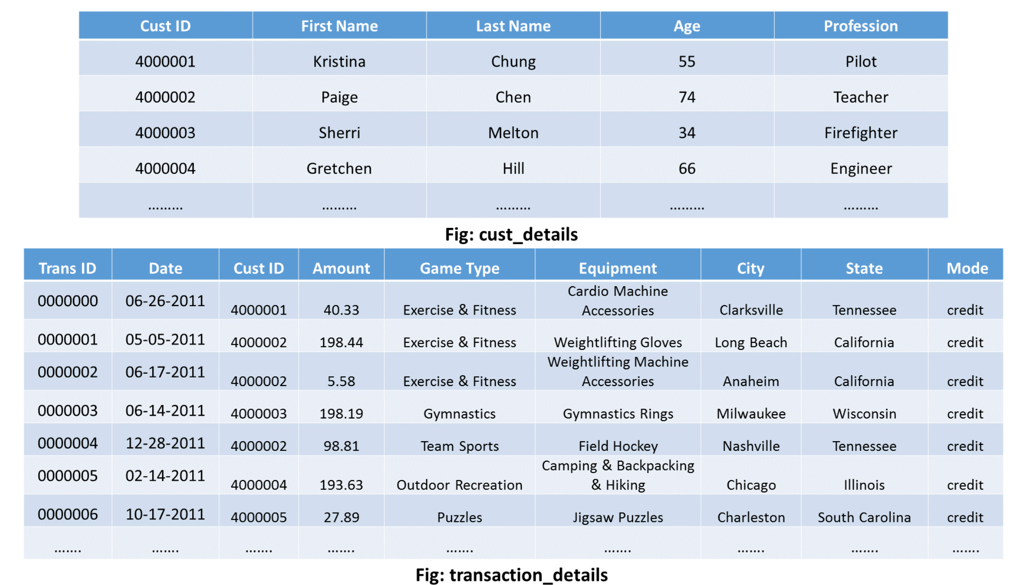
Another MapReduce Example
cust_details: It contains the details of the customer.
transaction_details: It contains the transaction record of the customer.
Two jobs:
1) The person’s first name along with the frequency of the visits by that person.
2) The total amount spent by him/her in all transactions
SELECT FirstName, count(TransID), sum(Amount)
FROM cust_details c LEFT JOIN transaction_details t
ON c.CustID=t.CustID
GROUP BY c.CustID
ORDER BY FirstName

Slide 25
Another MapReduce Example (cont.)
Map
A separate mapper for each of the two datasets i.e. One mapper for cust_details input and the other for transaction_details input.
The mapper for cust_details will produce following intermediate key-value pair:
- Key – Value pair: [cust ID, cust name]
Example: [4000001, cust Kristina], [4000002, cust Paige], etc.
The output of the mapper for transaction_details will be of the following format:
Key, Value Pair: [cust ID, tnxn amount]
Example: [4000001, tnxn 40.33], [4000002, tnxn 198.44], etc.

Slide 26
Another MapReduce Example (cont.)
2. Sort and Shuffle
The sorting and shuffling phase will generate a list of values corresponding to each key. The output of sorting and shuffling phase will be of the following format:
Key – list of Values:
{cust ID1 – [(cust name1), (tnxn amount1), (tnxn amount2), (tnxn amount3),…..]}
{cust ID2 – [(cust name2), (tnxn amount1), (tnxn amount2), (tnxn amount3),…..]}
……
Example:
{4000001 – [(cust kristina), (tnxn 40.33), (tnxn 47.05),…]};
{4000002 – [(cust paige), (tnxn 198.44), (tnxn 5.58),…]};
……

Slide 27
Another MapReduce Example (cont.)
3. Reduce
The final output should be of the following format:
Key – Value pair: [Name of the customer] (Key) – [total amount, frequency of the visit] (Value)
Examples
Kristina, (8 651.05)
Paige, (6 706.97)
…..

Slide 28
Another MapReduce Example (cont.)
public void reduce(Text key, Iterable<Text> values, Context context) throws IOException, InterruptedException
{
String name = ;
double total = 0.0;
int count = 0;
for (Text t : values)
{
String parts[] = t.toString().split( );
if (parts[0].equals( tnxn ))
{
count++;
total += Float.parseFloat(parts[1]);
}
else if (parts[0].equals( cust ))
{
name = parts[1];
}
}
String str = String.format( %d %f , count, total);
context.write(new Text(name), new Text(str));
}

Slide 29
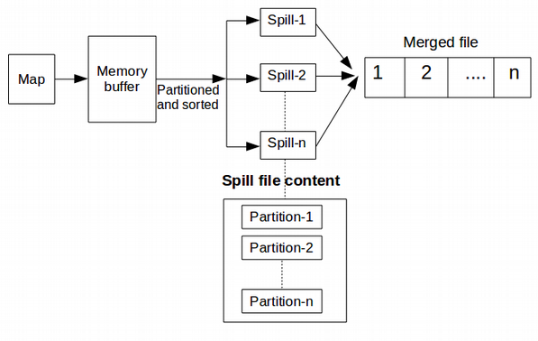
Sort&shuffle (mappers side)
Partition/sort in memory: Key/value pairs from mappers are stored in a buffer in memory. They are partitioned as per the number of reducers. Data is also sorted by keys with in a partition.
Spill: Output from Maps is written to disk as may temporary files.
Merge/Sort: Once the map task is finished all the files written to the disk are merged to create a single file.
Data locatity
Notes:
Before we spill key/value pairs stored in the buffer to hard disk, partition, sort
K1,v1 partition number = reducer number (0,1,2)
K2,v2…
Key%number of reducer 75%3 = 0 reducer
76%3 = 1
78%3 =0
Sort sort by partition number -> sort by key

Slide 30
Sort&shuffle (reducers side)
1. Shuffle: Data from a particular partition (from all mappers) is copied to a reducer that is suppose to process that particular partition.
2. Merge/sort in memory: Data copied from mappers is merged/sorted/stored in memory buffer at the reducer side too
3. Spill: If data transferred to a reducer exceeded the memory limit then it is copied to a disk.
4. Merge/sort: Once reducer has got its portion of data from all the mappers data is again merged while still maintaining the sort order of keys to create reduce task input.
5. Grouping: (the 1) (the 1) (the 1) -> (the, [1,1,1])
Spill 1
Reduce 1
Map-1
Patition1
Patition2
Memory Buffer
Spill 2
Merge
Reduce
Spill …
Map-2
Patition1
Patition2
Spill 10
Map-3
Patition1
Patition2
Spill 1
Reduce 2
Memory Buffer
Spill 2
Merge
Reduce
Spill …
Spill 10

Slide 31
Combiner in sort/shuffle
Generally in a MapReduce job, data is collected in the Map phase and later aggregated in reduce phase.
By specifying a combiner function in MapReduce you can aggregate data at the Map phase also.
You can specify in the MapReduce driver using job.setCombinerClass(youcombiner.class);
Combiner is mini-reducer(implements the Reducer interface’s reduce() method)
Works for some jobs.
Example: wordcount
Map-1: (the 1) (the 1), (the1) –combiner-> (the, 3)
Map-2: (the 1)(the 1) -> combiner (the, 2)
Reduce (the 5 )

Slide 32
Hadoop MapReduce jobs and tasks

Slide 33
MapReduce jobs and tasks
A job is a ‘full program’
– A complete execution of Mappers and Reducers over a dataset
A task is the execution of a single Mapper or Reducer over a slice of data
Notes:
Map -> reduce ->map -> reduce

Slide 34
MapReduce v1 and v2 (1)
MapReduce v1 ( MRv1 or Classic MapReduce )
– Uses a JobTracker/TaskTracker architecture
– One JobTracker per cluster – limits cluster size to about 4000 nodes
– Slots on slave nodes designated for Map or Reduce tasks
MapReduce v2 ( MRv2 )
– Built on top of YARN (Yet Another Resource Negotitor)
– Uses ResourceManager/NodeManager architecture
– Increases scalability of cluster
– Node resources can be used for any type of task
– Improves cluster utilization
– Support for non/MR jobs

Slide 35
MapReduce v1
JobTracker – one per cluster
– Manages MapReduce jobs, distributes individual tasks to
TaskTrackers
– TaskTracker – one per slave node
– Starts and monitors individual Map and Reduce tasks

Slide 36
Basic Cluster Configuration: HDFS + MapReduce v1

Slide 37
MapReduce V2
ResourceManager – one per cluster
– Starts ApplicationMasters, allocates resources on slave nodes
ApplicationMaster – one per job
– Requests resources, manages individual Map and Reduce tasks
NodeManager – one per slave node
– Manages resources on individual slave nodes
JobHistory – one per cluster
– Archives jobs’ metrics and metadata

Slide 38
Basic Cluster Configuration: HDFS + MapReduce v2

Slide 39
Running a Job on a MapReduce v1 Cluster

Slide 40
Running a Job on a MapReduce v2 Cluster

Slide 41
Job Data: Mapper Data Locality
When possible, Map tasks run on a node where the block of data to be processed is stored locally
Otherwise, the Map task will transfer the data across the network and then process that data

Slide 42
Job Data: Intermediate data
Map task intermediate data is stored on the local disk (not HDFS)

Slide 43
Job Data: sort and shuffle
Intermediate data is transferred across the network to the Reducers
Reducers write their output to HDFS

Slide 44
Is Shuffle and Sort a Bottleneck?
It appears that the shuffle and sort phase is a bottleneck
– The reduce method in the Reducers cannot start until all Mappers have finished
In practice, Hadoop will start to transfer data from Mappers to Reducers as soon as the Mappers finish work
– This avoids a huge amount of data transfer starting as soon as the last Mapper finishes
– The reduce method still does not start until all intermediate data has been transferred and sorted

Slide 45
Is a Slow Mapper a Bottleneck?
It is possible for one Map task to run more slowly than the others
– Perhaps due to faulty hardware, or just a very slow machine
It would appear that this would create a bottleneck
– The reduce method in the Reducer cannot start until every Mapper has finished
Hadoop uses speculative execution to mitigate against this
– If a Mapper appears to be running significantly more slowly than the others, a new instance of the Mapper will be started on another machine, operating on the same data a new task attempt for the same task
– The results of the first Mapper to finish will be used
– Hadoop will kill off the Mapper which is still running

